Slide 1
Project Title
Smartphone Usage Heatmap Analysis
Team Members:
Prof.Yugandhara Patil
Komal Kambire
Naina Malyal
Jayashri Ingale

Slide 2
Problem Statement
The rapid growth of smartphone usage, individuals are spending increasing amounts of time on their devices for communication, entertainment, and productivity. However, most users are unaware of their actual screen-time habits and how their usage varies across different times of the day and days of the week. This lack of awareness can lead to unhealthy digital behavior, reduced productivity, and potential mental well-being issues.
This project aims to explore smartphone screen-time data using data visualization techniques such as heatmaps and clustering methods. By identifying hourly and daily usage trends and grouping users into categories like Heavy, Balanced, and Minimal users, the study will provide insights into digital behavior patterns and promote better awareness of smartphone usage habits.

Slide 3
Technology Stack
Python – Used for data analysis, data preprocessing, and visualization due to its powerful data science libraries.
Pandas – For data cleaning, transformation, and manipulation of screen-time datasets.
NumPy – For numerical computations and handling large data arrays.
Matplotlib – To clearly display usage trends and patterns through graphs.
Seaborn – Used to generate heatmaps for hourly and daily smartphone usage patterns.
Machine Learning
Scikit-learn – For clustering users into categories (Heavy, Balanced, Minimal) using algorithms like K-Means Clustering.
Jupyter Notebook – For interactive coding, visualization, and step-by-step analysis.

Slide 4
Data Preprocessing
Data preprocessing is a crucial step in this project because raw smartphone usage data is often incomplete, inconsistent, or unstructured. Before performing visualization and clustering, the dataset must be cleaned and transformed into a usable format.
Data Cleaning
Raw screen-time data may contain:
Missing values (no data recorded for certain hours or days)
Duplicate records

Slide 5
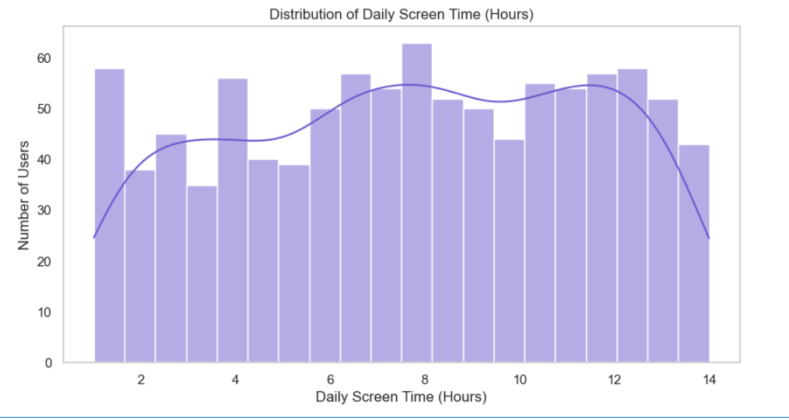
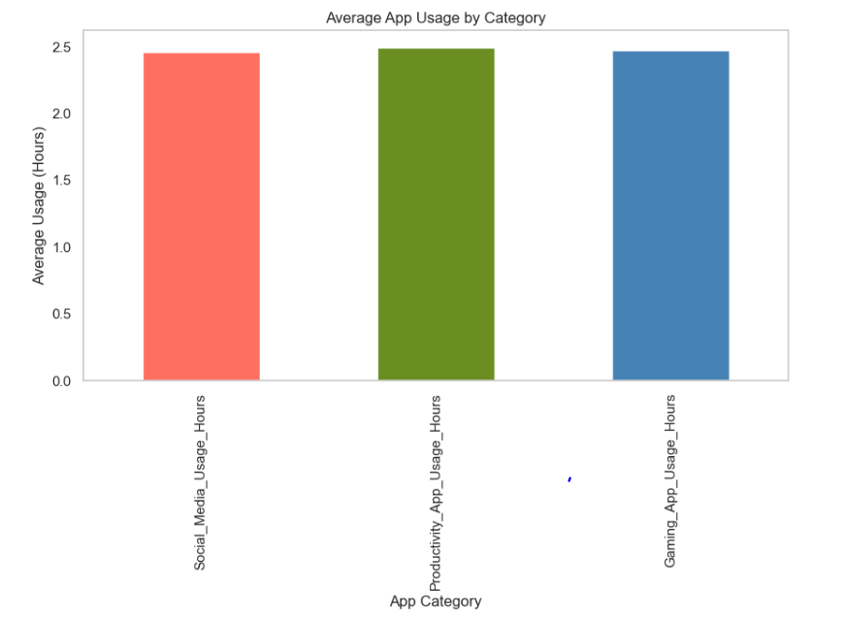
EDA
Exploratory Data Analysis (EDA) is the process of analyzing and visualizing data to understand its main characteristics, patterns, and relationships before applying machine learning techniques. In this project, EDA helps uncover smartphone usage behavior across different times and users.

Slide 6
Model Selection
Chosen Model: K-Means Clustering
The objective of this project is to identify usage behavior patterns without predefined labels. Since the dataset does not contain user categories beforehand, an unsupervised learning approach is most suitable.
How K-Means Fits This Project
Groups users based on screen time, app usage, and activity patterns
Helps classify users into:
  Minimal Users
  Balanced Users
  Heavy Users
Supports behavioral insights and visualization clarity

Slide 7
Results
User Category | Cluster ID | Avg Screen Time (hrs/day) | Avg App Usage Count | Avg Active Hours | % of Users
Minimal User | Cluster 0 | 1.5 – 2.5 hrs | 10 – 15 apps | 3 – 4 hrs | 30%
Balanced User | Cluster 1 | 3.0 – 4.5 hrs | 20 – 30 apps | 5 – 6 hrs | 45%
Heavy User | Cluster 2 | 6.0 – 8.5 hrs | 35 – 50 apps | 8 – 10 hrs | 25%

Slide 8
Conclusion
The project successfully analyzed smartphone usage data using visualization
and machine learning techniques.
Heatmaps effectively highlighted hourly and daily usage trends.
K-Means clustering classified users into Heavy, Balanced, and Minimal usage groups.
Behavioral segmentation provides valuable insights for digital well-being monitoring.
The model can be extended for screen-time recommendations and usage alerts.
Overall, the approach enables better understanding of digital behavior patterns.

